Slide 1





INCREASING BANK REVENUE
Members:
Ifeanyi Osuchukwu
Christian Ekwomadu
Meznah Alsulami
Grace Sigalla

Slide 2



Introduction & Problem Statement

Slide 3
Introduction
Data analytics is the process of exploring and analyzing large datasets to find hidden patterns, unseen trends, discover correlations, and derive valuable insights to make business predictions. It improves the speed and efficiency of your business.
In this project, we will be analyzing data from a Portuguese Bank to determine which customers to target digital advertisements to subscribe to a term deposit. We will also be building machine learning models that will identify high-value customers that will utilize bank products. Therefore, increasing the bank's overall revenue.

Slide 4
Problem Statement
The Portuguese Bank has experienced a reduction in revenue and is unsure of the best course of action. Following an inquiry, they discovered that their clients' inadequate investment in long-term deposits was the main contributing factor. Therefore, the bank wants to identify current clients who are more likely to sign up for a long-term deposit and concentrate marketing efforts on them.

Slide 5

Research Questions
How can we identify existing customers that have a high likelihood of subscribing for a term deposit?
How can we utilize data from direct marketing campaigns from this bank such as phone call surveys in which clients were asked if they would subscribe to a bank term deposit?
How can we use the dataset about a client classify and predict whether that client will subscribe to a term deposit?

Slide 6
Goals and objective of this project
To develop a classification and predictive model to determine whether a client will subscribe (‘Yes’) or Not-subscribe (‘No’) to a long-term deposit and
Use this information from the model to help the bank focus on customers most likely to subscribe for term deposits when they are working on ad campaigns, which the bank can use to get more subscribers, in turn their profitability should increase as well.

Slide 7
Data Source and Data Preparation
Data Source: https://www.kaggle.com/datasets/rashmiranu/banking-dataset-classification
Data was obtained from direct marketing campaigns from this bank. This information is from phone call surveys, in which clients were asked if they would subscribe to a bank term deposit. The dataset created captures 21 inputs about a given client.
Original Format: comma-separated values (CSV)

Slide 8
Relevant Variables and Details
Age (numeric): The age of the Client
Job (Categorical, nominal): The Job of the Client
Marital: Marital Status of the Client. ('divorced', 'married', 'single', 'unknown'; note: 'divorced' means divorced or widowed)
Default (categorical, nominal): has credit in default? ('no', 'yes', 'unknown')
Loan: has personal loan? ('no', 'yes', 'unknown')
Housing: has housing loan? ('no', 'yes', 'unknown')
Contact (categorical, nominal): contact communication type ('cellular', 'telephone')
Month (categorical, ordinal): last contact month of year ('Jan', 'Feb', 'Mar', …, 'Nov', 'Dec')

Slide 9
Relevant Variables and Details
Dayofweek (categorical, ordinal): last contact day of the week ('Mon', 'Tue', 'wed', 'Thu', 'Fri')
Duration (numeric): last contact duration, in seconds . Important note: this attribute highly affects the output target (e.g., if duration=0 then y='no')
Pdays (numeric): number of days that passed by after the client was last contacted from a previous campaign (999 means client was not previously contacted)
Previous (numeric): number of contacts performed before this campaign and for this client
Poutcome (Categorical, nominal): outcome of the previous marketing campaign ('failure', 'nonexistent', 'success')
Y (binary): has the client subscribed a term deposit? ('yes', 'no')
Campaign (numeric): number of contacts performed during this campaign and for this client (includes last contact)

Slide 10

Exploratory Data Analysis & Cleansing

Slide 11
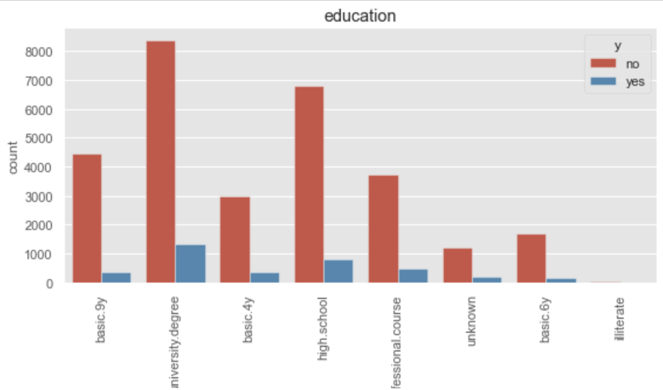
Bivariate Analysis of Education Status vs Target
Based on this analysis those individuals with university degree are more likely to subscribe for a term deposit account..

Slide 12
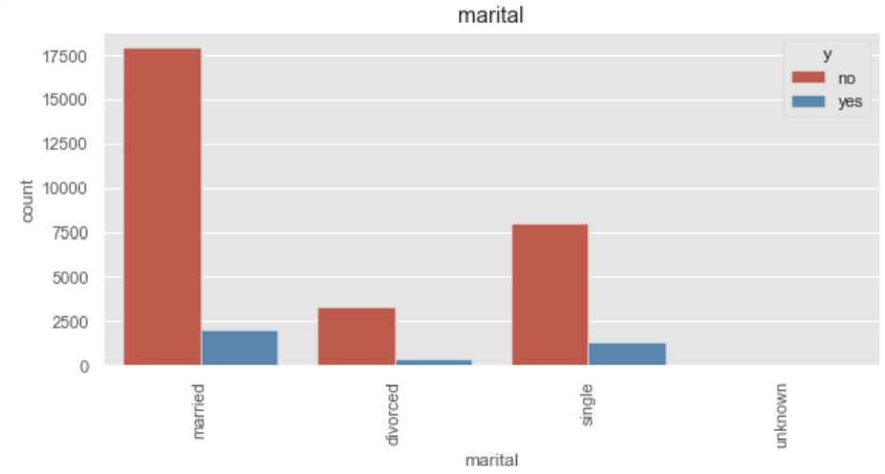
Bivariate Analysis of Marital Status vs Target
Individuals who are married are more likely to subscribe to term deposit account.

Slide 13
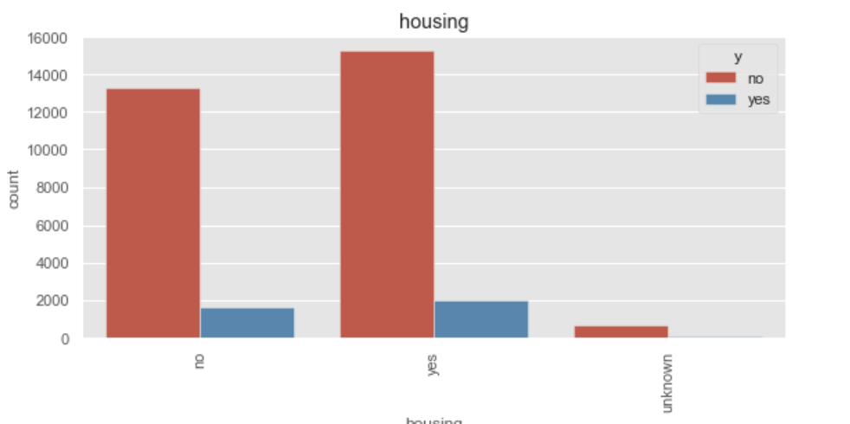
Bivariate Analysis of Housing Loan vs Target
Housing loans doesn't affect the likelihood of individuals subscribing to term deposit account.

Slide 14
Major Data Insights
The median age of the banks clientele is 38.
60% of all customers are married.
42% of all customers have a college degree.
52% of all customers currently have a housing loan.
Only 15% of customers have a personal loan with the bank.
33% of customers were contacted in the month of May.

Slide 15
Major Data Insights
The median duration time is 180 seconds.
The top three professions are admin, blue-collar , and technician
Cell-phones were the main method of reaching out to customers .

Slide 16

Methodology

Slide 17
Methodology
Three Models were developed using python to discover which customers would be good candidates for long term deposits accounts.
Random Forest, Support Vector(linear) , and Logistic Regression.
Identify which features in our model are the most important and determining ideal candidates.
Models will be evaluated on performance via precision, recall, accuracy, and F-score metrics.

Slide 18
Modeling and Results
Overview: To develop a classification and predictive model to determine whether a client will subscribe (‘Yes’) or Not-subscribe (‘No’) to a long-term deposit

Slide 19
Modeling
Dependent Variable: Binary variable, yes/no
Models:
Random Forest
Logistic Regression
Support Vector Machine
Scope:
Training set has 32,950 customer records
Testing set has 8238 customer records

Slide 20
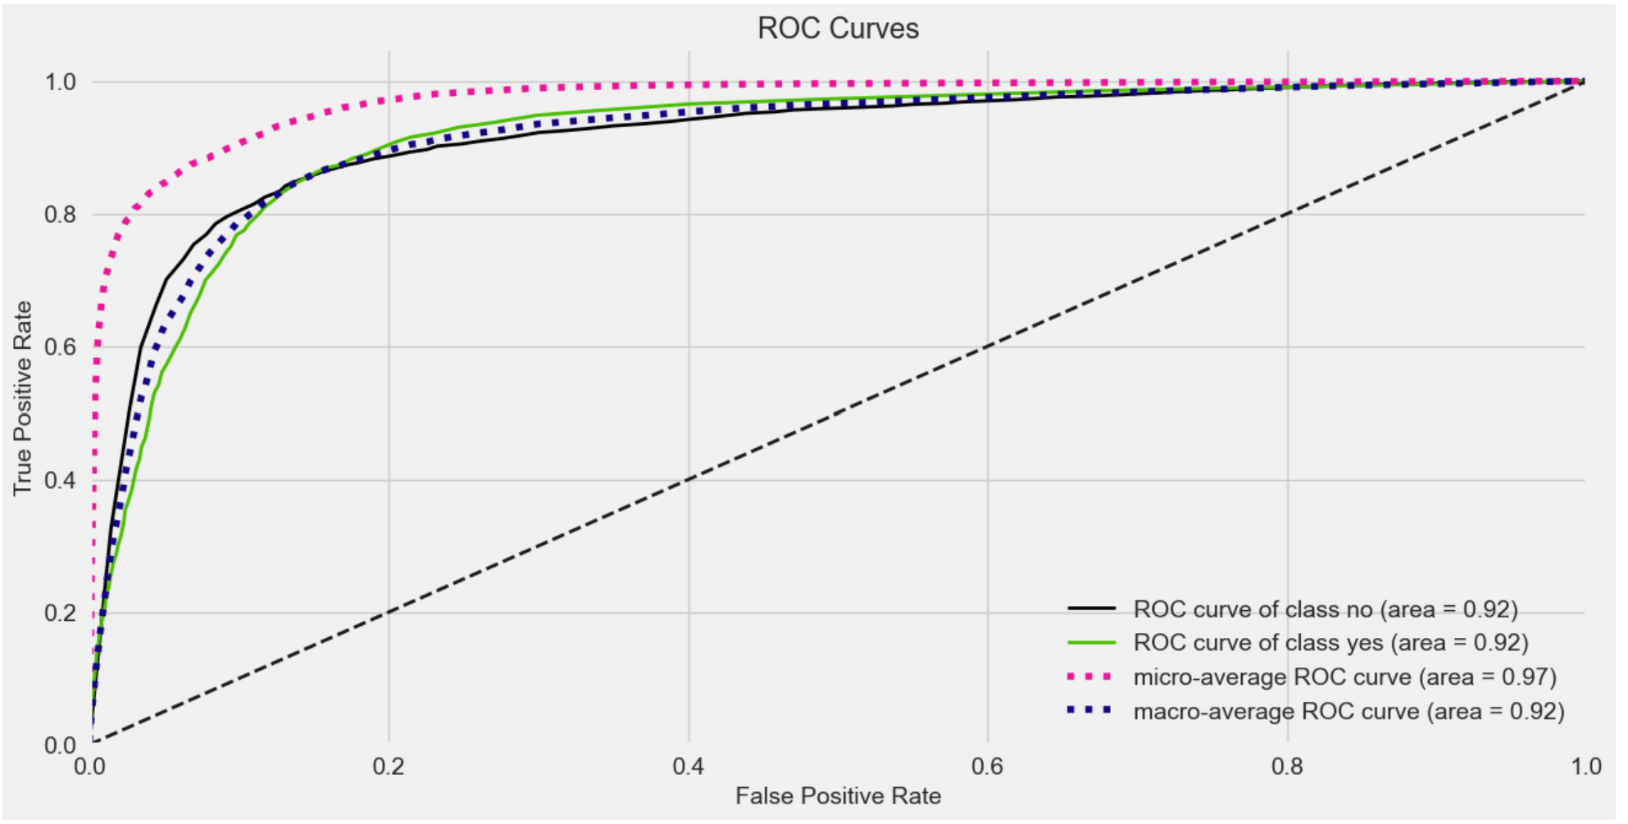
Random Forest
Model produced a 90.26% accuracy level on the training dataset

Slide 21
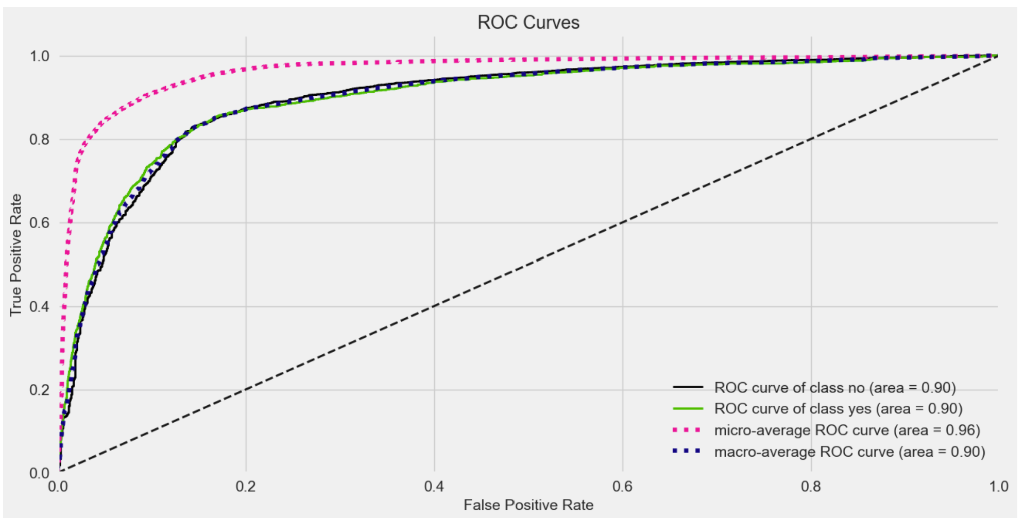
Support Vector Machine
Model produced a 89.39% accuracy level on the training dataset

Slide 22
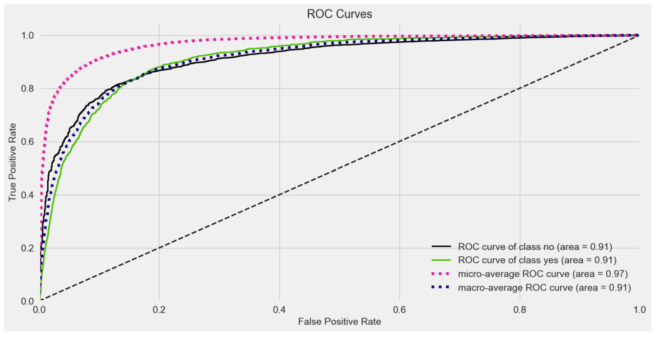
Logistic Regression
Model produced a 90.51% accuracy level on the training dataset

Slide 23
Results
All three models implemented, successfully (>90% accuracy) classified bank customers as candidates for term deposit accounts.
This shows it is possible to predict which bank customers will enroll for a term deposit account given the data provided from the bank.

Slide 24


Evaluation

Slide 25
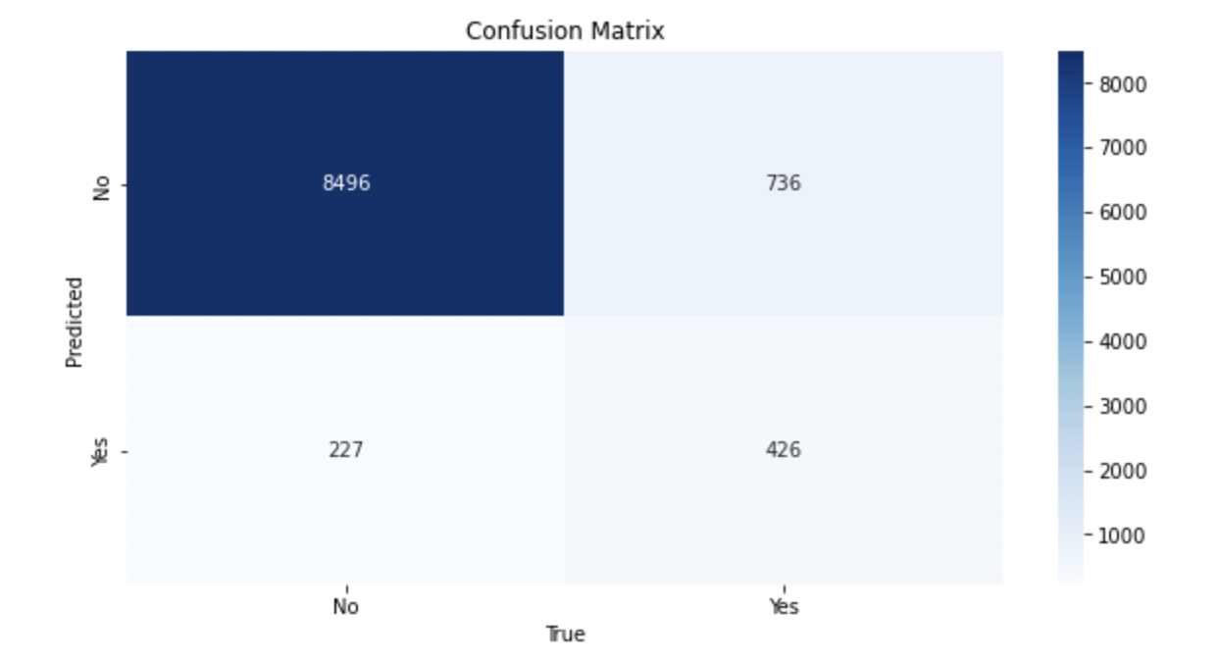
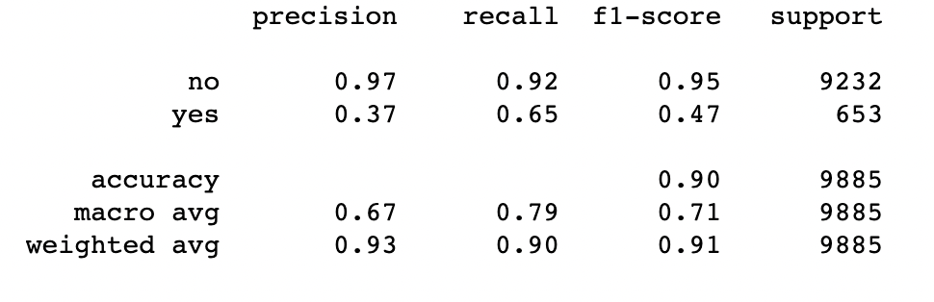
Random Forest Machine Model – Confusion Matrix
Random Forest Machine Learning Model predicted positively that 426 customers would subscribe to a term deposit and that 8496 customers would not subscribe.

Slide 26
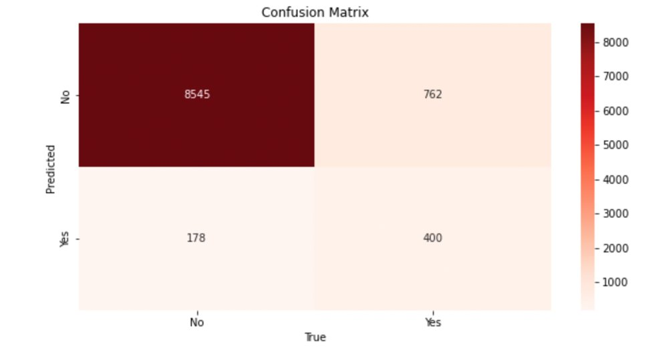
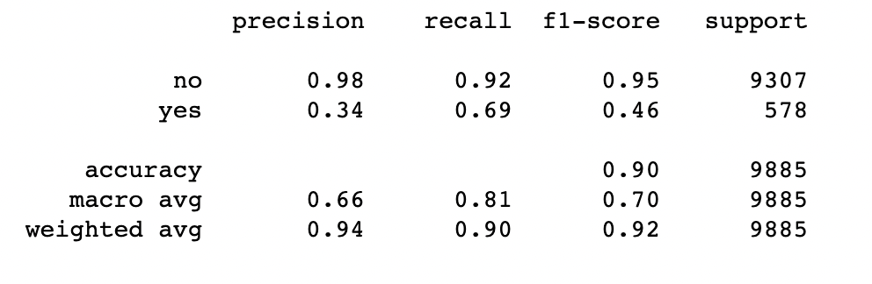
Support Vector Machine Model
Support Vector Machine Learning Model predicted positively that 400 customers would subscribe to a term deposit and that 8545 customers would not subscribe.

Slide 27
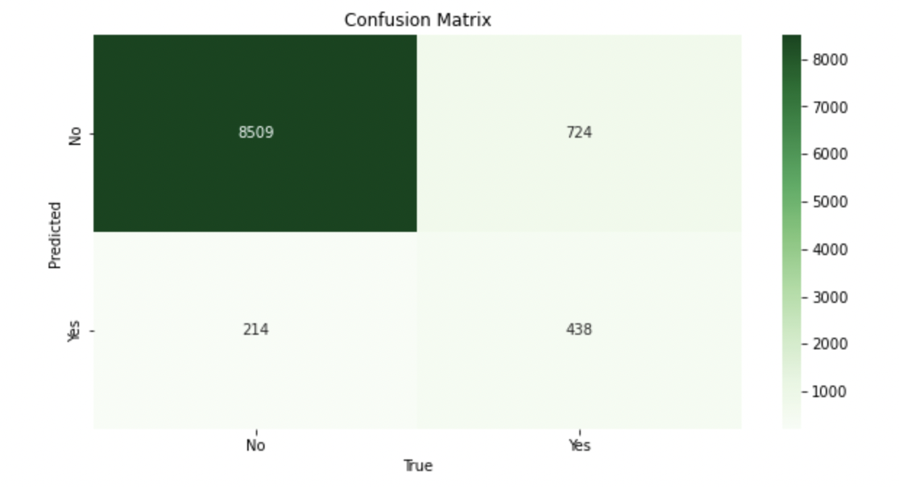
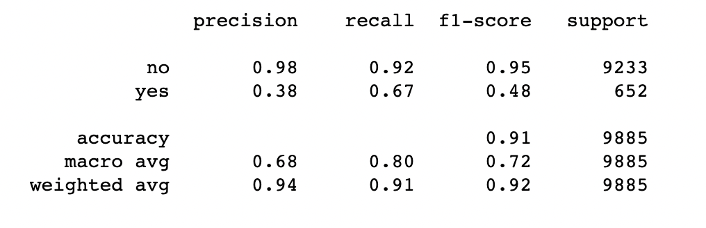
Logistic Regression Model
Logistic Regression Machine Learning Model predicted positively that 438 customers would subscribe to a term deposit and that 8509 customers would not subscribe.

Slide 28
Evaluation Results
Based on the confusion matrix evaluation for all 3 models, logistic regression was the better model with true positive predictions at 438 and true negative predictions at 8509!

Slide 29
Conclusion & Future Work
Our prediction models can identify customers that make good candidates for term deposit accounts. This is extremely valuable as we now have a means of a targeted marketing approach for those customers.
Using this information will allow the bank to focus on high-value customers that are most likely to subscribe to term deposit account. Their advertising campaigns will be concise.
In the future if the bank can successfully target customers, revenue should increase as more customers will sign-up for term deposit accounts. .
Future work: Run models monthly to identify customers and create an ad campaign that will convert customers to term deposit accounts .

Slide 30

Thank You!

